Slide 1
Prepare for the PSAT/NMSQT® 2017

Slide 2
Contents
What Is the PSAT/NMSQT®?
When Is the 2017 PSAT/NMSQT?
Skills Tested on the PSAT/NMSQT
How to Prepare for the PSAT/NMSQT
Sample PSAT/NMSQT Questions
Resources

Slide 3
What Is the PSAT/NMSQT?

Slide 4
Some Key Facts
Scores for the SAT® Suite of Assessments (SAT, PSAT/NMSQT®, PSAT™ 10, and PSAT™ 8/9) are reported on a common vertical scale, allowing educators to measure students progress
Propels students toward college and career readiness
Is cosponsored by the College Board and National Merit Scholarship Corporation
Serves as an entry point to nearly $160 million in scholarship dollars
3.8+ million students take the PSAT/NMSQT each year to get feedback on their skills and practice for the SAT.

Slide 5
What to know about the PSAT/NMSQT
Test length: 2 hours 45 minutes
No penalty for guessing or blank responses, also known as “rights-only scoring”
Personalized SAT practice through Khan Academy® with students' own PSAT/NMSQT scores
Scale ranges for the scores are 320 – 1520 for the total score

Slide 6
Benefits of the PSAT/NMSQT
Personalized SAT practice on Khan Academy based on students' PSAT/NMSQT answers
Aligned to the SAT
Increased access to additional scholarship providers
Online college and career planning tools
Admission and financial aid information from colleges
Majors and career exploration with College Board and Roadtrip Nation

Slide 7
PSAT/NMSQT 2017 Test Dates
Primary
Test Date
Saturday
Test Date
Alternate
Test Date
OCT
11
OCT
14
OCT
25

Slide 8
Skills Tested on the PSAT/NMSQT

Slide 9
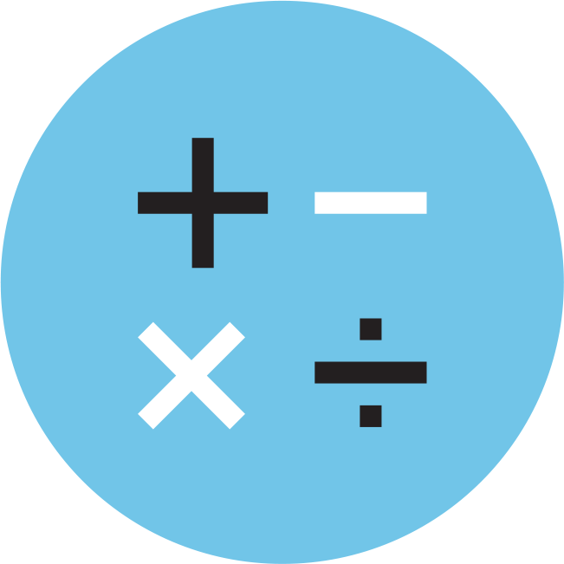
Skills Tested
Reading Test
Writing and Language Test
Math Test
Each test assesses the academic skills that students have developed over the years, primarily through their coursework.
These skills are considered essential for success in high school, college, and career.

Slide 10
Reading Test
5 Passages
47 Passage-Based Questions; 60 minutes
Quick Facts
All questions are multiple choice and based on passages.
Some passages are paired with other passages or informational graphics such as charts, graphs, and tables.
No mathematical computation is required.
Prior topic-specific knowledge is never tested.

Slide 11
Reading Test
What to Expect
In the Reading Test, students will encounter questions like those asked in a lively, thoughtful, evidence-based discussion.

Slide 12
Writing and Language Test
4 Passages
44 Passage-Based Questions; 35 minutes
Quick Facts
All questions are multiple choice and based on passages.
Some passages are paired with informational graphics such as charts, graphs, and tables.
No mathematical computation is required.
Prior topic-specific knowledge is never tested.

Slide 13
Writing and Language Test
What to Expect
The Writing and Language Test puts students in the active role of an editor who is improving a written passage. Most questions ask students to decide which, if any, of the three alternatives to an underlined part of a passage most improves it.

Slide 14
Math Test
2 Test Sections; 70 minutes
48 Questions (40 multiple choice, 8 grid-ins)
Quick Facts
Most math questions will be multiple choice, but some will be student-produced responses (grid-ins).
The Math Test is divided into two portions: Math Test – Calculator and Math Test – No Calculator.
Some parts of the test will present students with a scenario and then ask several questions about it.

Slide 15
Math Test
What to Expect
The Math Test focuses on the math that matters most for college and career readiness. To succeed on the Math Test, students will need to demonstrate mathematical practices, such as problem solving and using appropriate tools strategically.

Slide 16
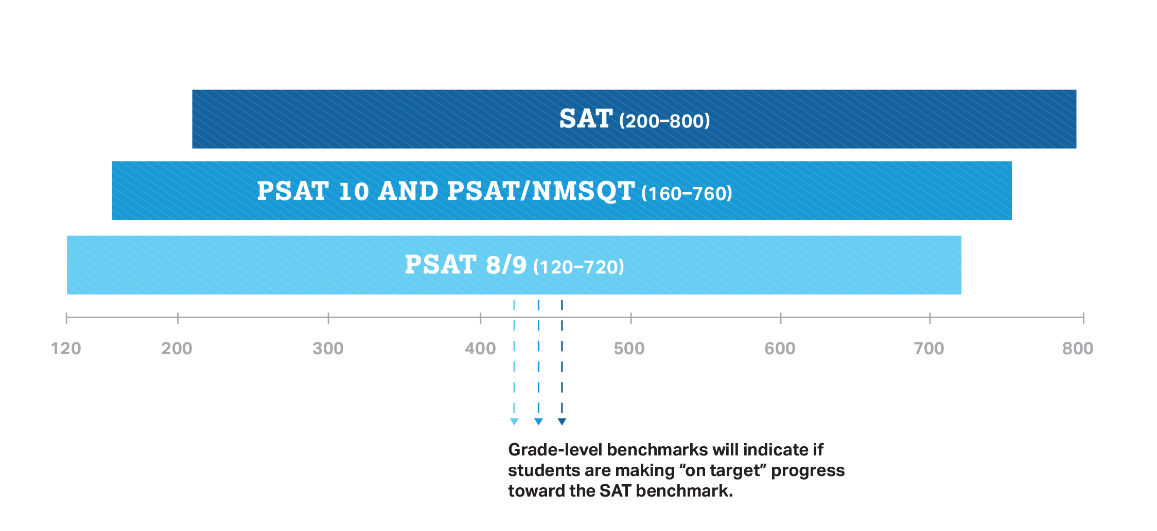
How Does the PSAT/NMSQT Connect to the SAT?
Content and Domain Alignment
All tests in the SAT Suite of Assessments (SAT, PSAT/NMSQT, PSAT 10, and PSAT 8/9) are aligned to the same research backbone and focus on the same domain of knowledge and skills.
Scoring
All tests in the SAT Suite of Assessments are on a common score scale that provides consistent feedback, enabling teachers to adjust instruction to better support students who are ahead or behind.

Slide 17
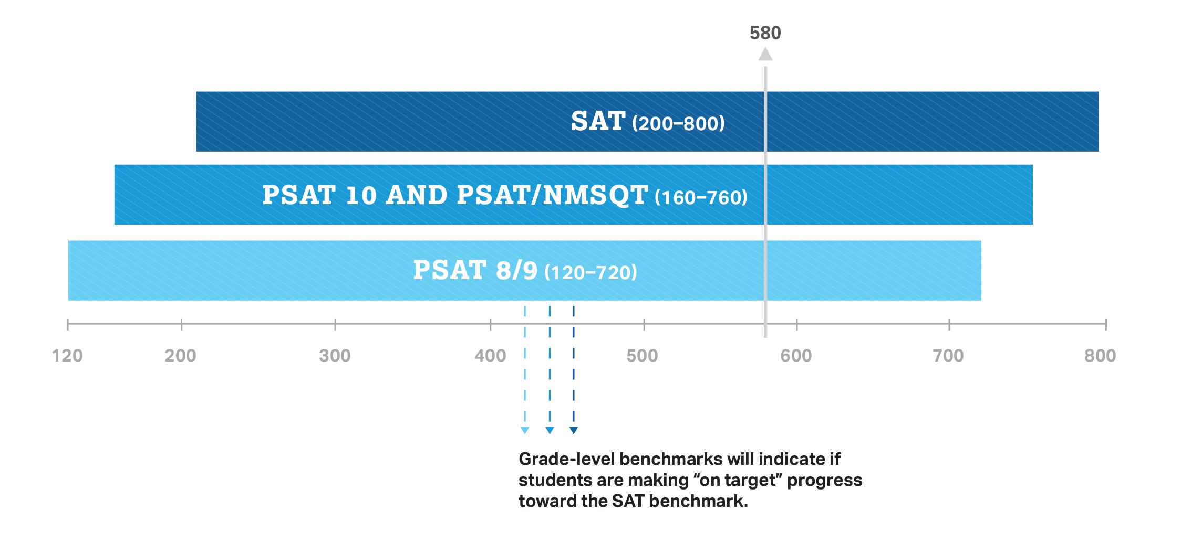
How Does the PSAT/NMSQT Connect to the SAT?
That means the score students get on the PSAT/NMSQT is the same score they would have gotten on the SAT if they’d taken it on the same day.

Slide 18
How Does the PSAT/NMSQT Compare to the SAT?
PSAT/NMSQT
2 hours 45 minutes
X
160—760
SAT
3 hours 50 minutes
Optional
200—800
Time
Essay
Section Score Range

Slide 19
How to Prepare for the PSAT/NMSQT

Slide 20
Know How the PSAT/NMSQT Is Scored
Rights-Only Scoring
1 point for each correct answer
0 points deducted for each incorrect or blank question
Math Grid-ins
You can enter answers as (reduced) fractions or decimals.
If rounding a decimal, make sure to use every box.
Scale
160–760 for each test section
320–1520 for the total score

Slide 21
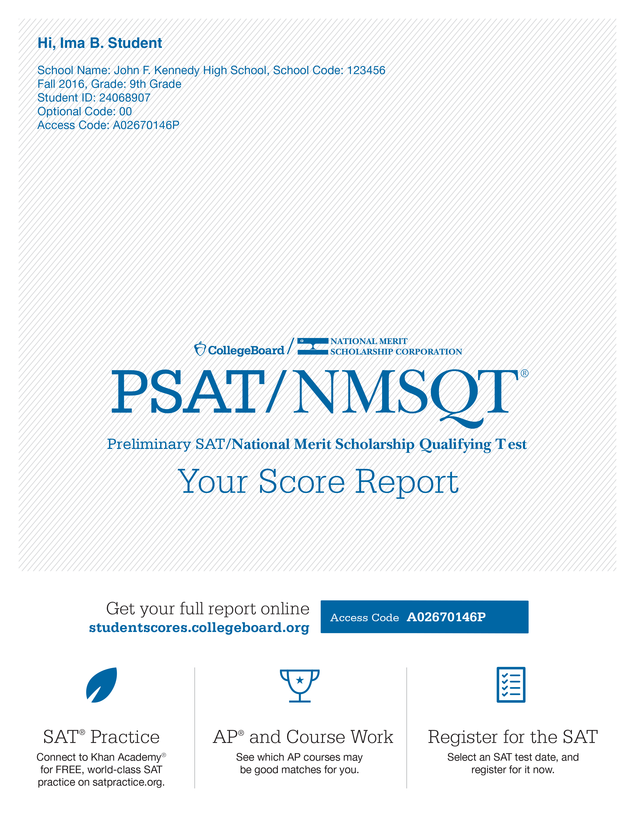
Personalized Skills Information
The PSAT/NMSQT Score Report
Contains information to help students improve academic skills.
Lists skills that students have the best chance of improving with additional work.
Connects to personalized practice recommendations on Khan Academy.

Slide 22
Preparation Starts in School
Read
Continuous reading improves vocabulary and develops essential skills.
Take Challenging Courses
This will help students to develop and strengthen their critical thinking skills.

Slide 23
Sample PSAT/NMSQT Questions

Slide 24
Reading Test
Passage-Based Questions

Slide 25
Reading Test
Passage-Based Questions

Slide 26
Reading Test
Passage-Based Questions

Slide 27
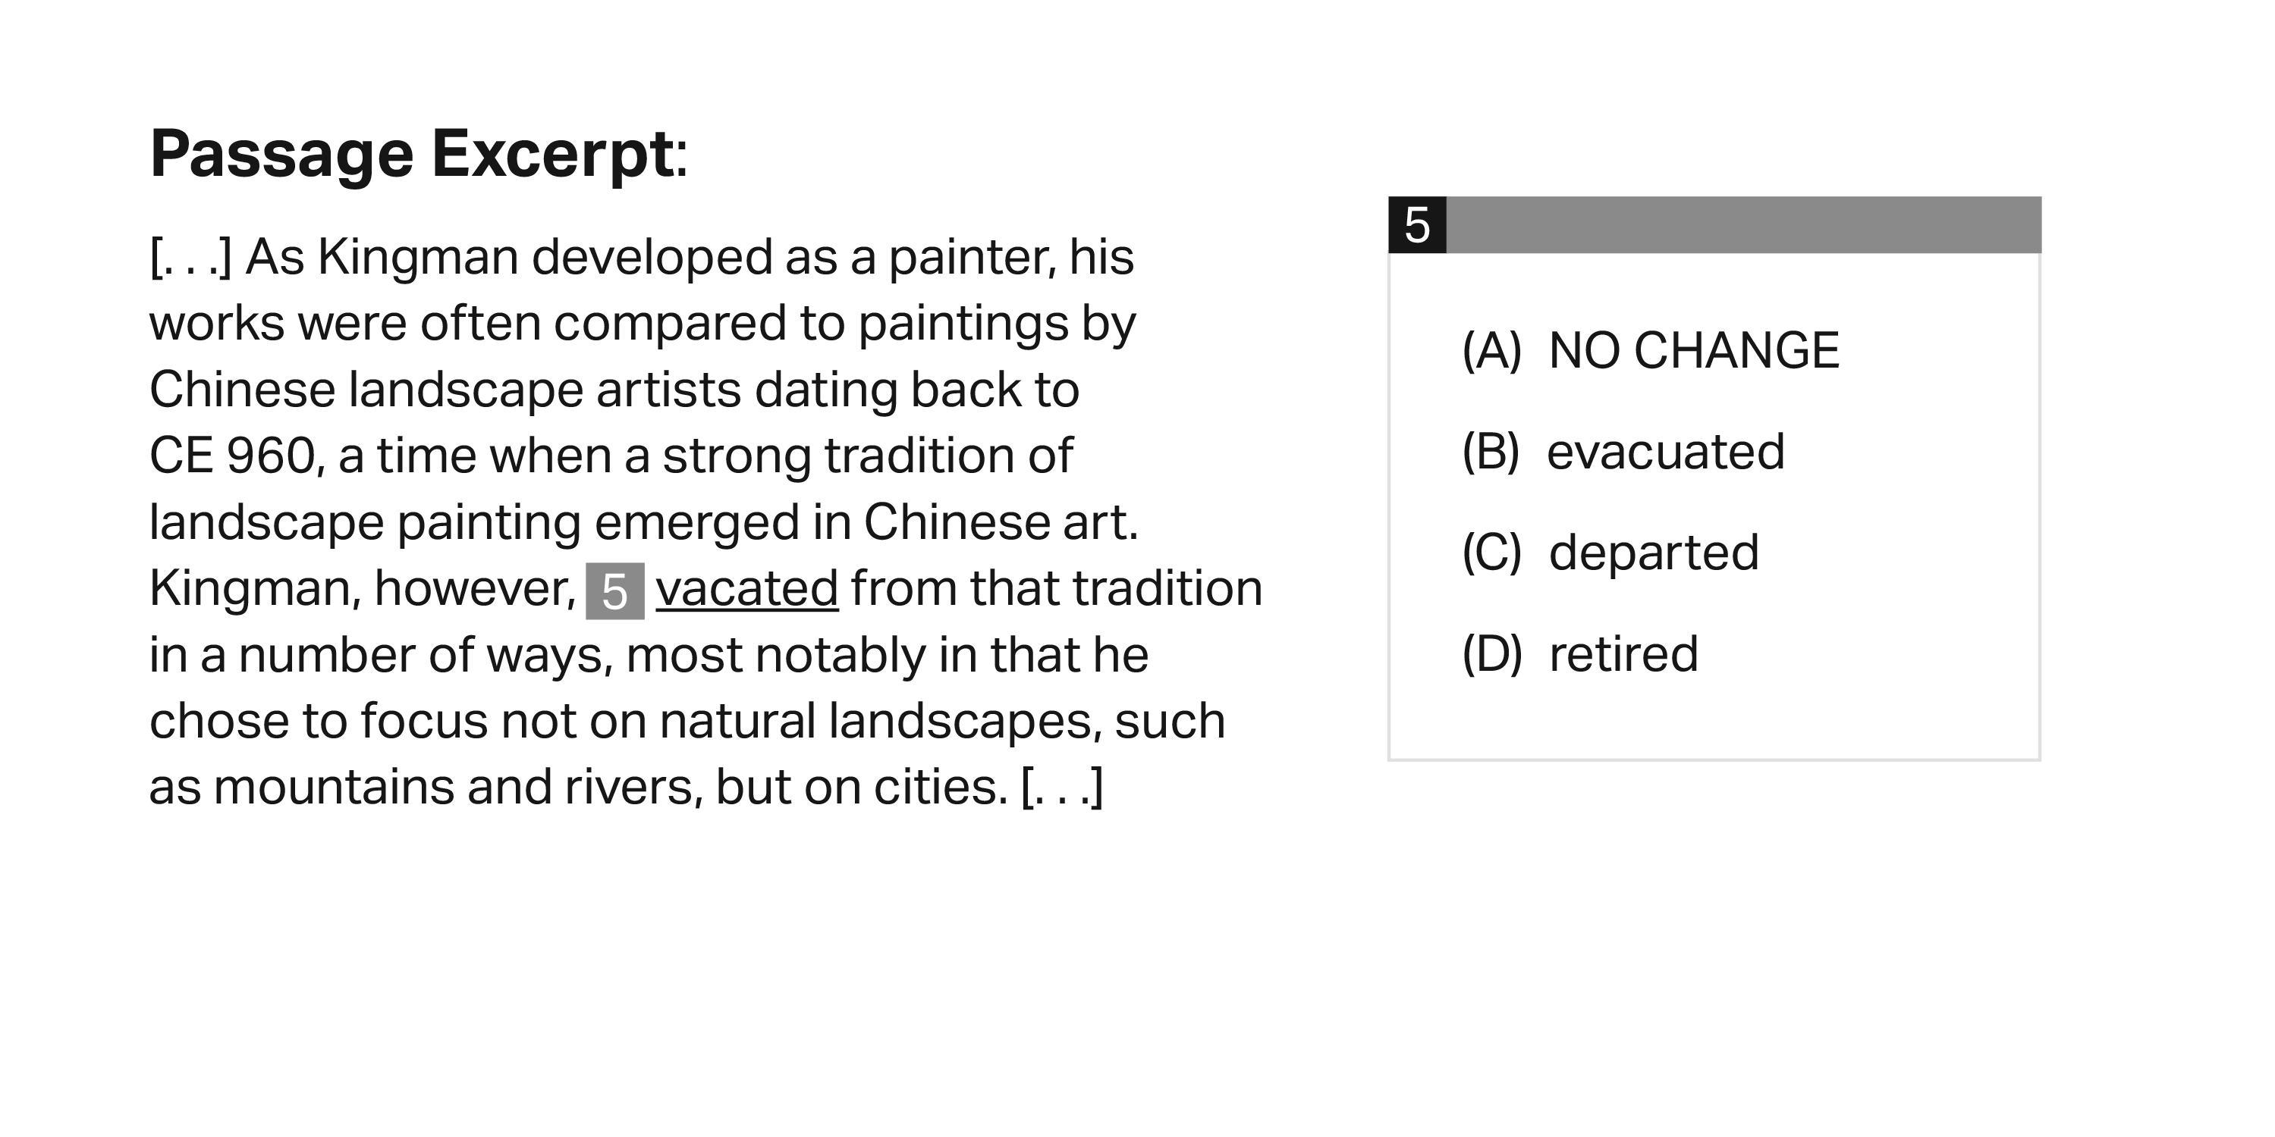
Writing and Language Test
Passage-Based Questions

Slide 28
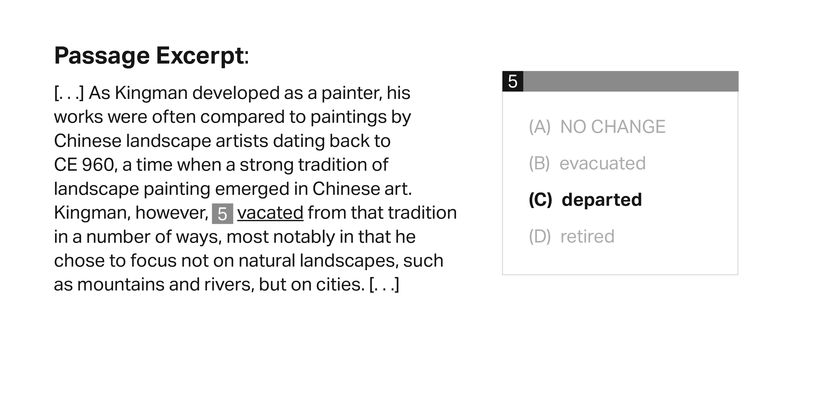
Writing and Language Test
Passage-Based Questions

Slide 29
Writing and Language Test
Passage-Based Questions

Slide 30
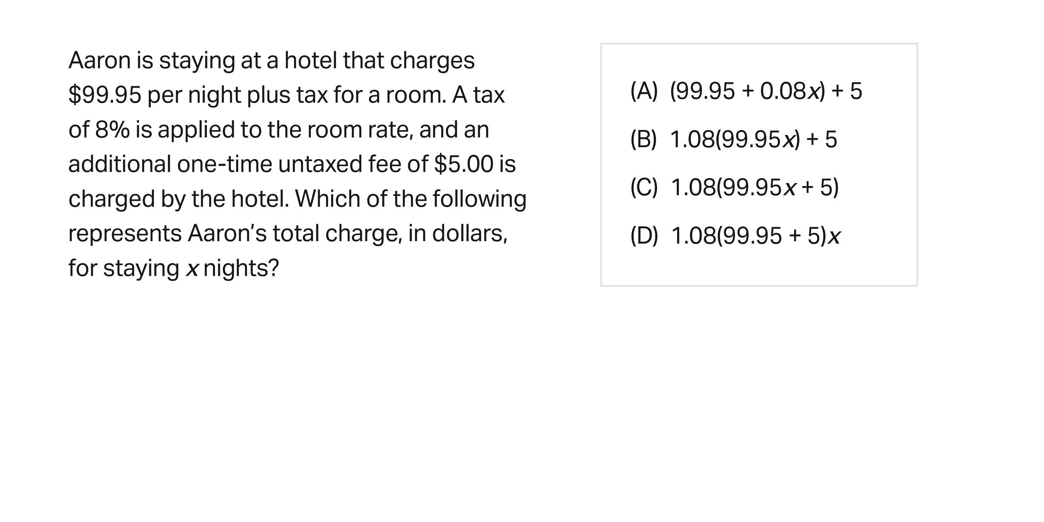
Math Test
Calculator: Permitted

Slide 31
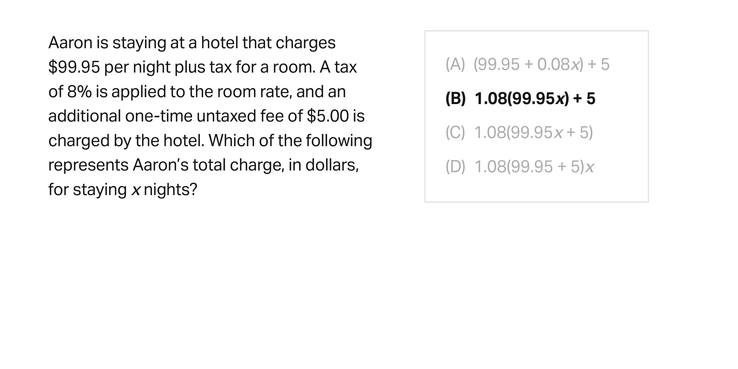
Math Test
Calculator: Permitted

Slide 32
Math Test
Calculator: Permitted

Slide 33
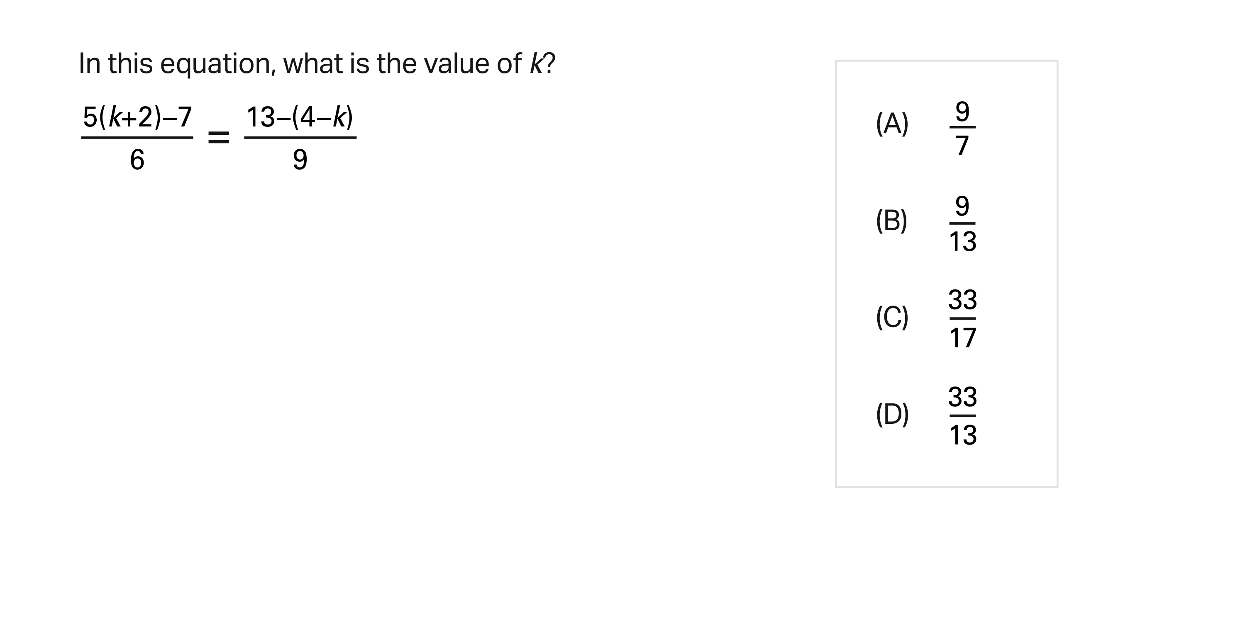
Math Test
Calculator: Not Permitted

Slide 34
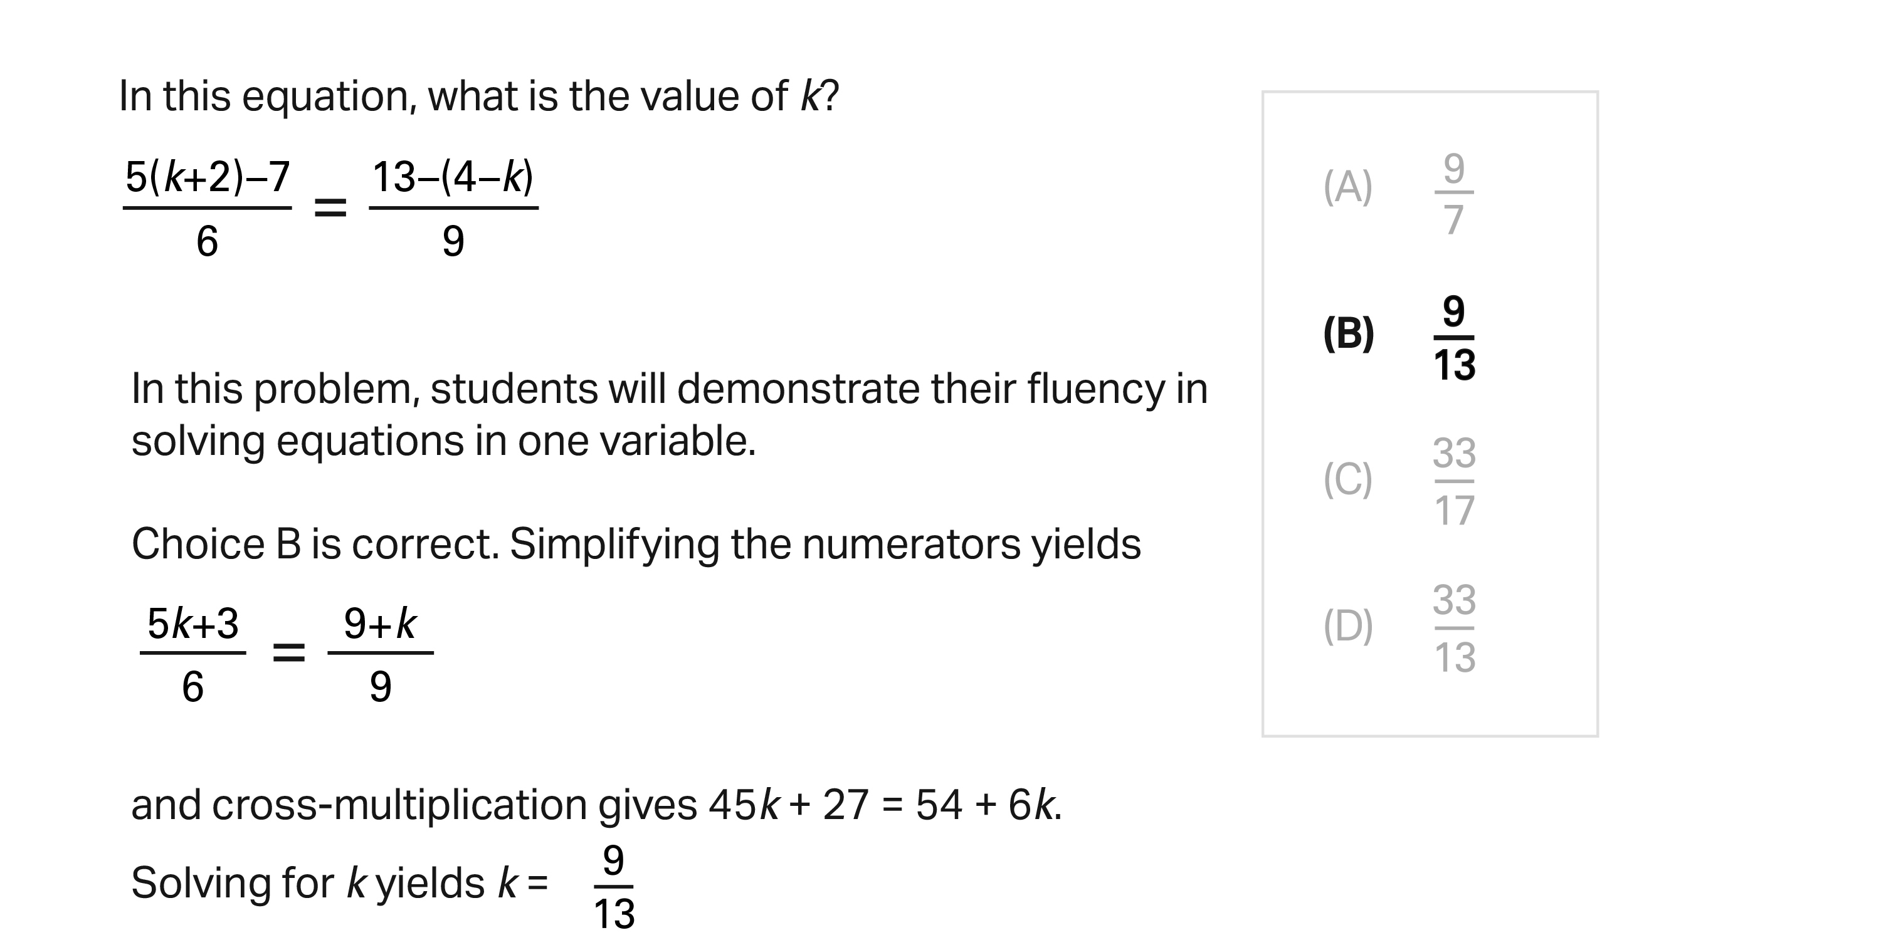
Math Test
Calculator: Not Permitted

Slide 35
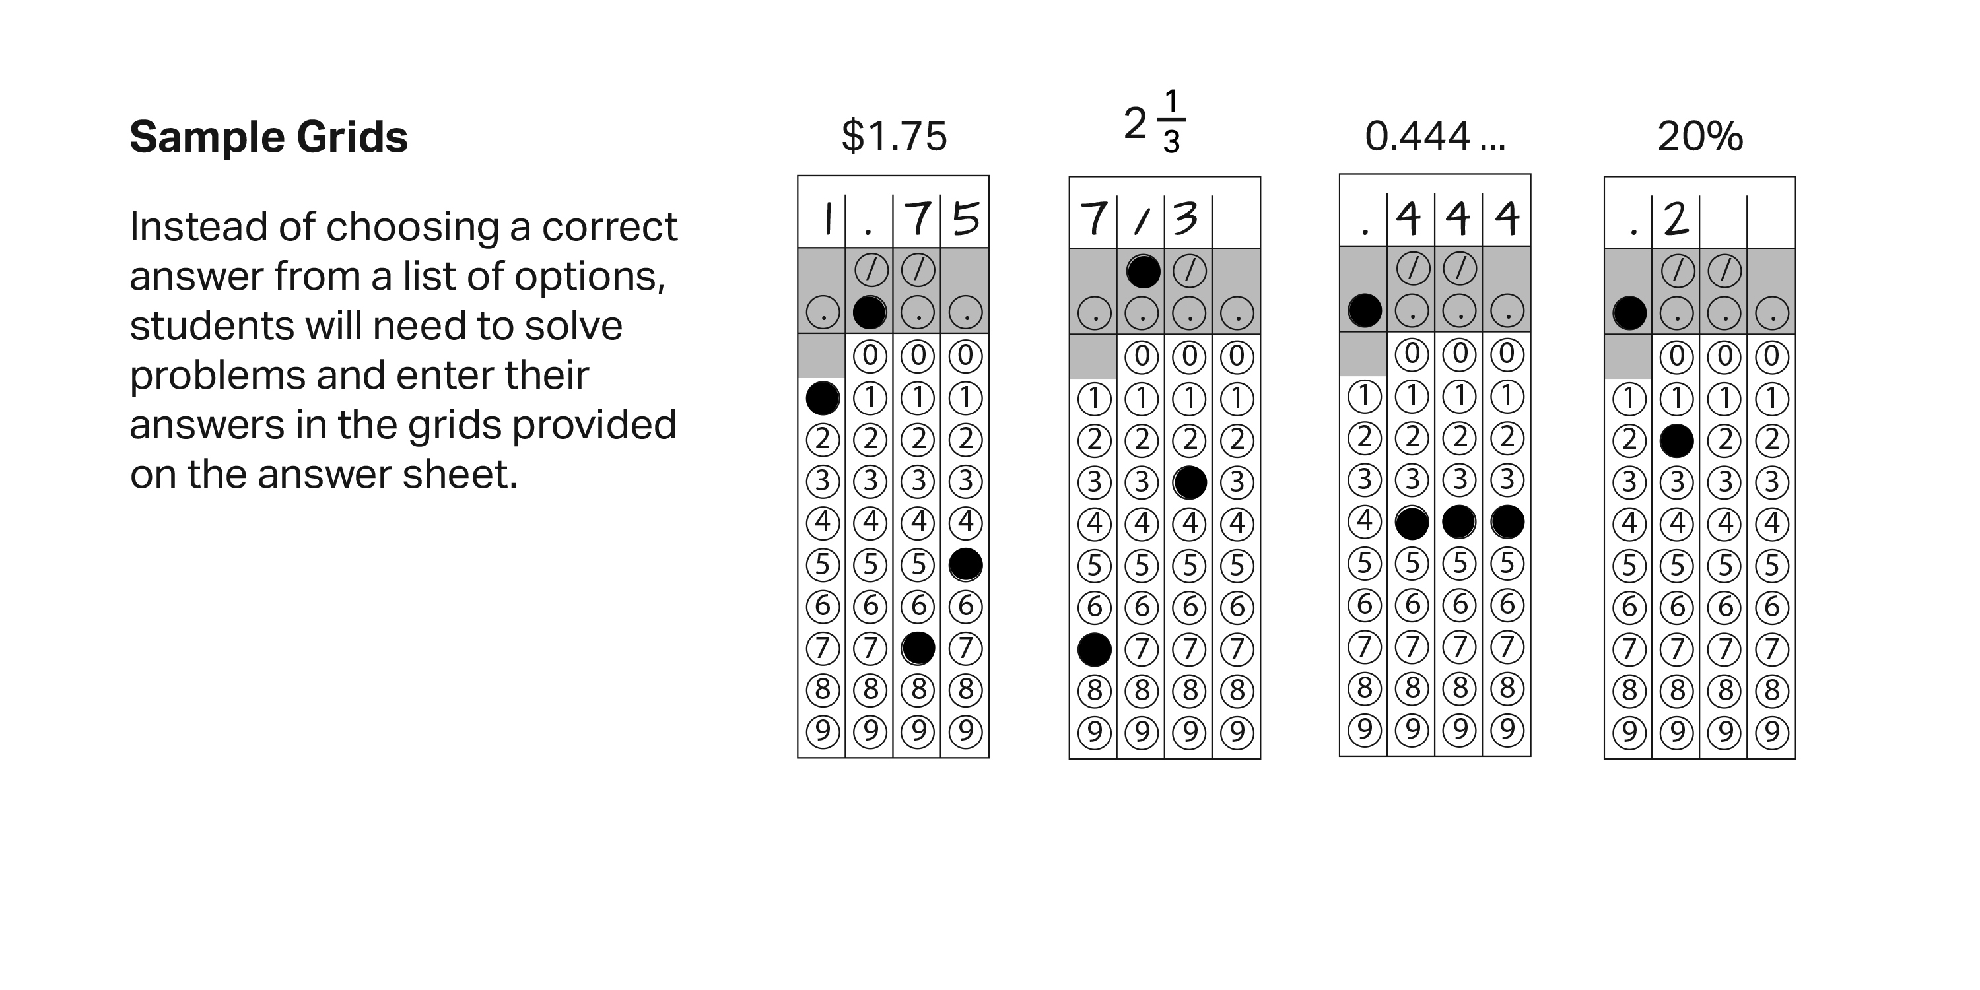
Math Section
Student-Produced Responses

Slide 36
Math Section
Students: Know Your Calculator
A scientific or graphing calculator is recommended.
Students should bring a familiar calculator. Test day is not the time to figure out how to use a new calculator.
Math Test – Calculator

Slide 37
Math Section
Additional Calculator Tips for Students
Don’t try to use the calculator on every question―no question requires one.
Decide how to solve each problem; then decide whether to use a calculator.
Make sure your calculator is in good working order and that batteries are fresh.
Students will not be permitted to use laptops or other computers, tablets, cell phones, or smartphones, etc. Please reference the student guide for a complete list.
Math Test – Calculator

Slide 38
Resources

Slide 39
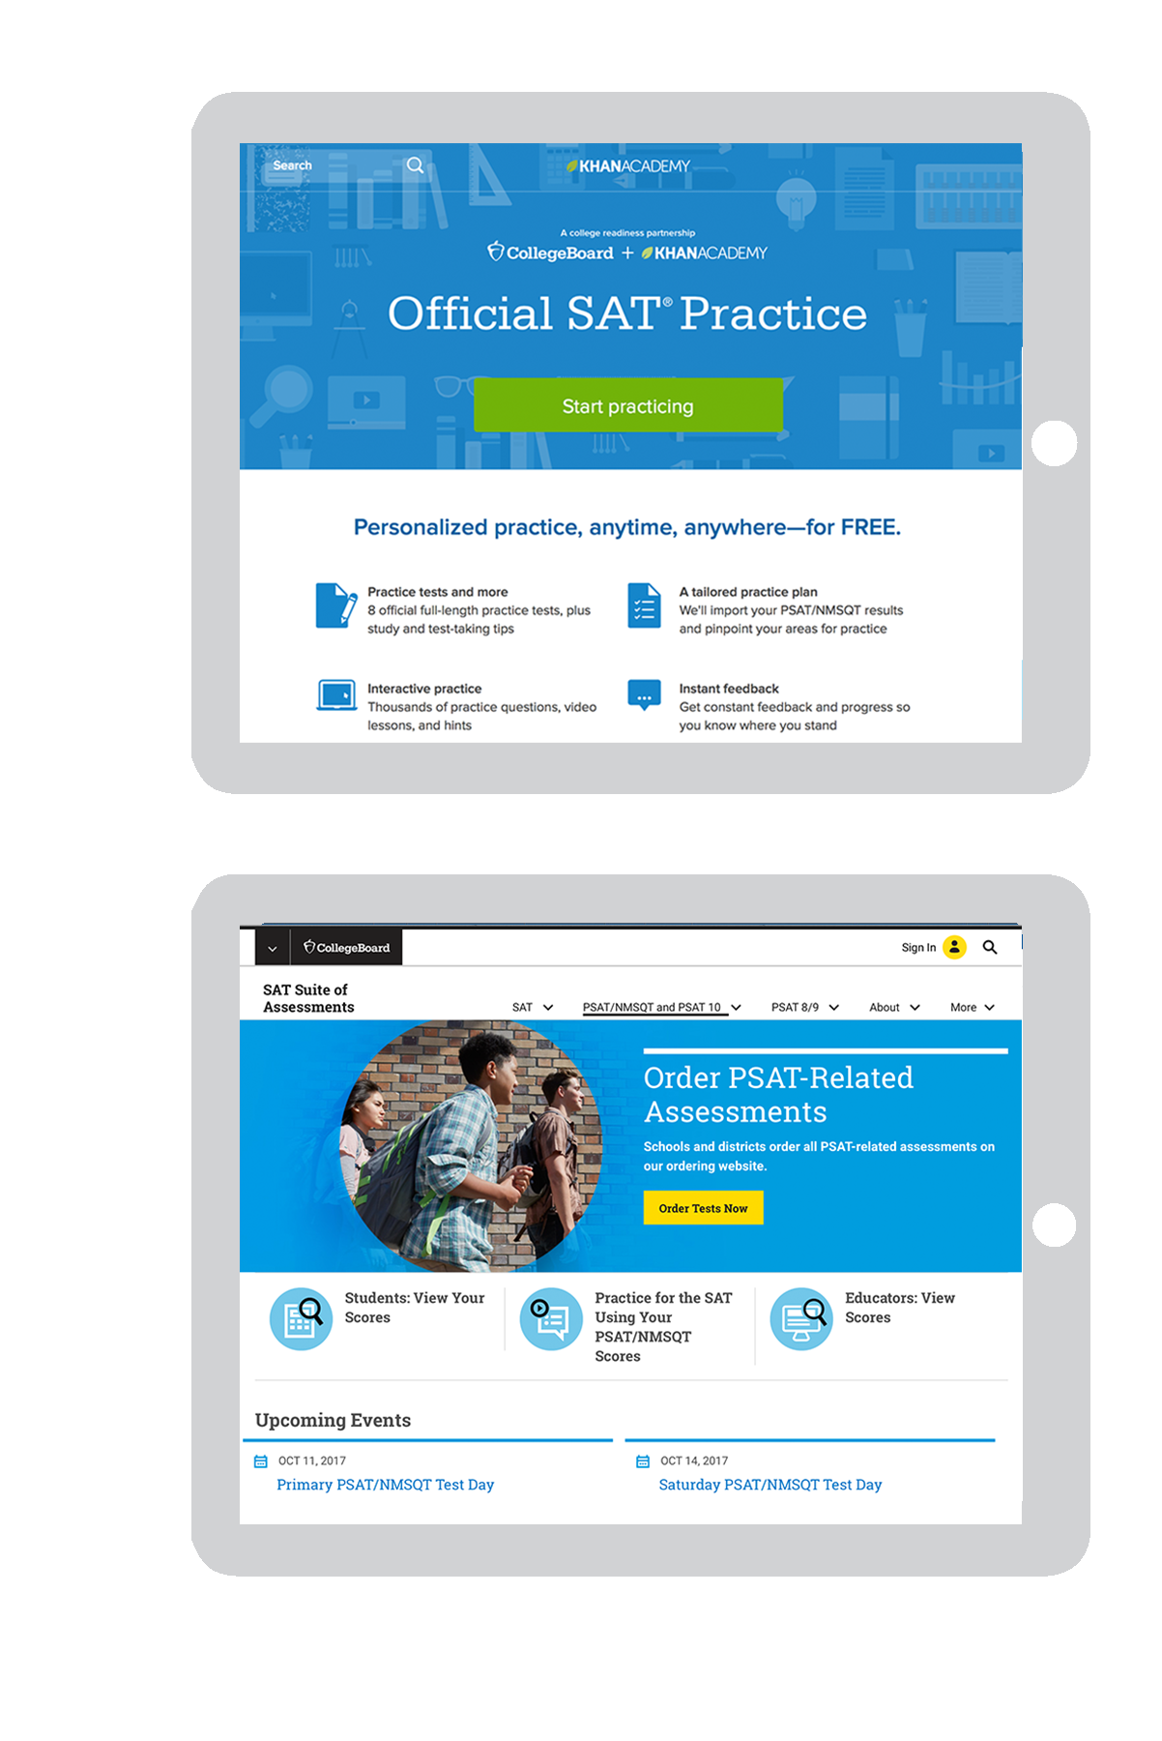
Resources
For personalized resources aligned to the SAT Suite of Assessments (including the PSAT/NMSQT), please visit:
satpractice.org
For general information about the PSAT/NMSQT, please visit:
collegeboard.org/psat

Slide 40
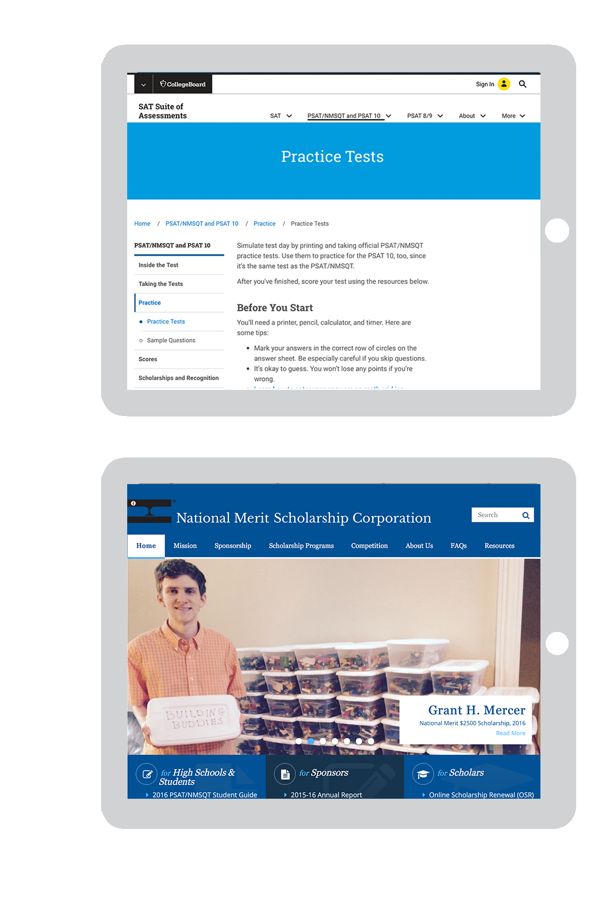
Resources
Take the practice test in the PSAT/NMSQT Student Guide, available through your counselor or at:
collegeboard.org/psatpractice
To find out more about National Merit Scholarship Corporation and its scholarships, visit:
nationalmerit.org

Slide 41
Take the 2017 PSAT/NMSQT
How to Sign Up:
Test Day/Date:
Time:
Location:
____________________
____________________
____________________
____________________
Make sure you bring:
Two No. 2 pencils
Calculator (optional)

Slide 42
Good luck!

